Slide 1
MPI Point to Point Communication
CDP

Slide 2
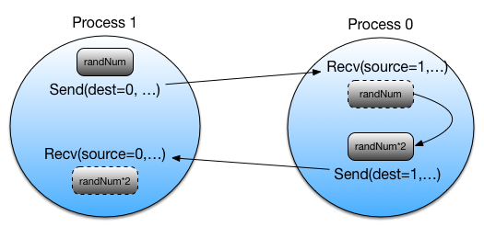
Reminder
import numpy
from mpi4py import MPI
comm = MPI.COMM_WORLD
rank = comm.Get_rank()
randNum = numpy.zeros(1)
if rank == 1:
randNum = numpy.random.random_sample(1)
comm.Send(randNum, dest=0, tag=88)
comm.Recv(randNum, source=0, tag=77)
print(randNum)
elif rank == 0:
comm.Recv(randNum, source=1, tag=88)
randNum *= 2
comm.Send(randNum, dest=1, tag=77)

Slide 3
Message Passing Definitions
Application
Application buffer
Holds the data for send or receive
Handled by the user
System buffer
Space for storing messages
Depending upon the type of send/receive operation
Allows communication to be asynchronous
Handled by the system
For MPI_Send
The MPI standard allows the implementation to use a system buffer but does not require it
Helpful Link
Application Buffer
from mpi4py import MPI
MPI Library
System Buffer

Slide 4
Communication modes
Standard send
The basic send operation used to transmit data from one process to another
Synchronous send
Blocks until the corresponding receive has actually occurred on the destination process
Ready send
When a matching receive has already been posted
otherwise, an error occurs
Buffered send
The programmer allocates a buffer for the data to be placed in until it can be sent
Standard receive
The basic receive operation used to accept data sent from another process.
May be used to receive data from any of the possible send operations

Slide 5

Blocking communication
A communication routine is blocking if the completion of the call is dependent on certain "events"
Sends
The data must be successfully sent or safely copied to system buffer space, so that the application buffer that contained the data is available for reuse
Receives
The data must be safely stored in the receive buffer, so that it is ready for use
This is MPI’s way to avoid data race between the application and the MPI library

Slide 6
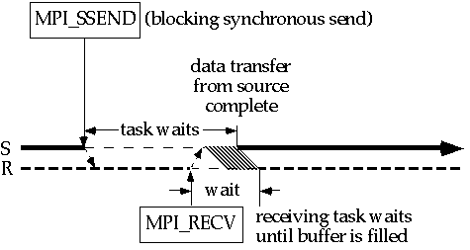
Blocking Synchronous Send
Blocks until the corresponding receive has actually occurred on the destination process
Most of the waiting on the sending end can be eliminated if MPI_Recv will come before MPI_Ssend
Notes:
Both sides of the communication are in a known state (i.e. synchronized)
No need to use any kind of bufer

Slide 7
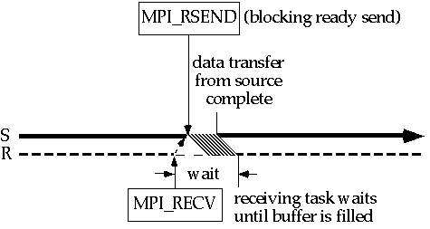
Blocking Ready Send
When a matching receive has already been posted
otherwise, an error occurs
By default, the program exits if MPI_Rsend is called before notification arrives (no error code will be returned)
Notes:
1 less message
No way to check if recv called – need to know according to your alg.
For example: if you just received a message from the other process, then you can know that it immediately will call MPI_Recv

Slide 8
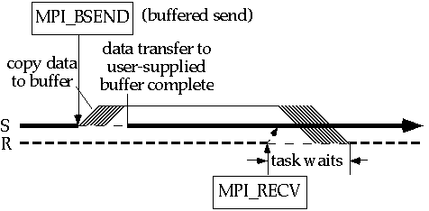
Blocking Buffered Send
The programmer allocates a buffer for the data to be placed in until it can be sent
Timing of MPI_Recv is irrelevant.
MPI_Bsend returns as soon as data are copied from source to a buffer.
Notes:
Error code will be returned when application buffer is out of space.
Need to call MPI_Buffer_attach() before to attach an application buffer to the process.
MPI_Buffer_detach() will block until all the data on the buffer was successfully sent.

Slide 9
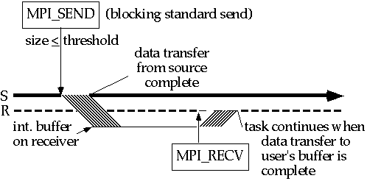

Blocking Standard Send
The basic send operation used to transmit data from one process to another
Message size $≤$ threshold
Notes:
We can use either the sending system buffer or the receiving system buffer

Slide 10
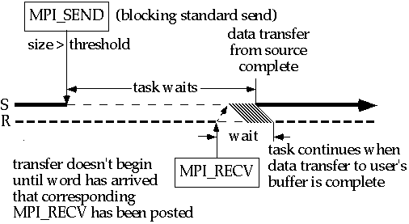
Blocking Standard Send
The basic send operation used to transmit data from one process to another
Message size > threshold
Notes:
Allows more freedom to the library developers to include as many optimization as they want

Slide 11
Conclusions: Modes
Synchronous mode
“Safest“
Most portable
Ready mode
Lowest total overhead
Buffered mode
Decouples sender from receiver
Allows user control
Standard mode
Implementation-specific compromise

Slide 12
Question 1
import numpy
from mpi4py import MPI
comm = MPI.COMM_WORLD
rank = comm.Get_rank()
msg = numpy.zeros(512)
if rank == 1:
comm.Ssend(msg, dest=0, tag=88)
comm.Recv(msg, source=0, tag=77)
elif rank == 0:
comm.Ssend(msg, dest=1, tag=77)
comm.Recv(msg, source=1, tag=88)
Print(“worker: ”, rank)
Answers:
Both “worker: 0” and “worker: 1”
Only “worker: 0”
Nothing
It depends
Notes:
C

Slide 13
Question 2
import numpy
from mpi4py import MPI
comm = MPI.COMM_WORLD
rank = comm.Get_rank()
msg = numpy.zeros(512)
if rank == 1:
comm.Ssend(msg, dest=0, tag=88)
comm.Recv(msg, source=0, tag=77)
elif rank == 0:
comm.Recv(msg, dest=1, tag=77)
comm.Ssend(msg, source=1, tag=88)
Print(“worker: ”, rank)
Answers:
Both “worker: 0” and “worker: 1”
Only “worker: 0”
Nothing
It depends
Notes:
C because tags are wrong

Slide 14
Question 3
import numpy
from mpi4py import MPI
comm = MPI.COMM_WORLD
rank = comm.Get_rank()
msg = numpy.zeros(512)
if rank == 1:
comm.Rsend(msg, dest=0, tag=88)
elif rank == 0:
comm.Recv(msg, dest=1, tag=88)
Print(“worker: ”, rank)
Answers:
Both “worker: 0” and “worker: 1”
Only “worker: 0”
Nothing
It depends
Notes:
D because 1 may run first and have an error

Slide 15
Question 4
import numpy
from mpi4py import MPI
comm = MPI.COMM_WORLD
rank = comm.Get_rank()
msg = numpy.zeros(512)
if rank == 1:
comm.Ssend(msg, dest=0, tag=88)
comm.Recv(msg, source=0, tag=77)
elif rank == 0:
MPI_Buffer_attach(numpy.zeros(1024))
# allocated a buffer for Bsend
comm.Bsend(msg, dest=1, tag=77)
comm.Recv(msg, source=1, tag=88)
MPI_Buffer_detach(buff)
Print(“worker: ”, rank)
Answers:
Both “worker: 0” and “worker: 1”
Only “worker: 0”
Nothing
It depends
Notes:
A

Slide 16
Question 5
import numpy
from mpi4py import MPI
comm = MPI.COMM_WORLD
rank = comm.Get_rank()
msg = numpy.zeros(512)
if rank == 1:
comm.Send(msg, dest=0, tag=88)
comm.Recv(msg, source=0, tag=77)
elif rank == 0:
comm.Send(msg, dest=1, tag=77)
comm.Recv(msg, source=1, tag=88)
Print(“worker: ”, rank)
Answers:
Both “worker: 0” and “worker: 1”
Only “worker: 0”
Nothing
It depends
Notes:
D

Slide 17
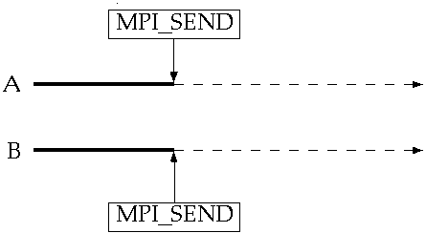
Deadlock
Both processes send message to each other
No one will be able to call a corresponding MPI_Recv
Notes:
When message > threshold

Slide 18
Avoiding deadlock
Different ordering of calls between tasks
Buffered mode
Non-blocking calls
Later on…
Other communication functions
For example: MPI_Sendrecv

Slide 19
Non-blocking communication
Method returns immediately
Unsafe to use buffers before actual completion
Check status of call via dedicated methods
later on…
Allows overlapping of computation and communication

Slide 20
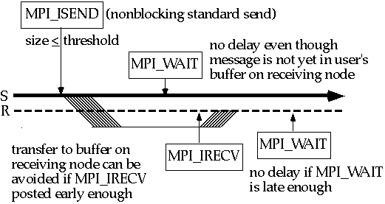
Non-blocking standard send Non-blocking receive
MPI_Isend(…)
MPI_Irecv(…)
Notes:
MPI_Request request: a handle for the non-blocking call
Can be used by MPI_Wait/MPI_Test (later on)

Slide 21
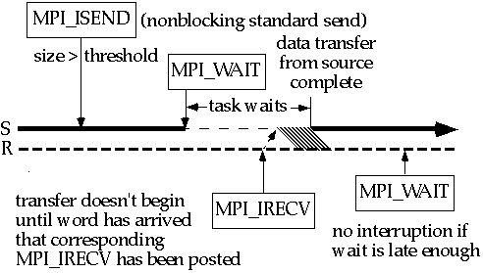
Non-blocking standard send Non-blocking receive
MPI_Isend(…)
MPI_Irecv(…)

Slide 22
Information About Non-Blocking MPI Call
MPI_Wait
request.Wait()
Blocking until communication is completed
Useful for both sender and receiver of non-blocking communications
MPI_Test
request.Test()
Non Blocking check for status of communication
Useful for both sender and receiver of non-blocking communications
MPI_Cancel
request.Cancel()
Cancels the Non Blocking call

Slide 23
Non-blocking standard send Non-blocking receive
MPI_Isend(…)
MPI_Irecv(…)
Notes:
MPI_Request request: a handle for the non-blocking call
Can be used by MPI_Wait/MPI_Test (later on)

Slide 24
Non-blocking standard send Non-blocking receive
MPI_Isend(…)
MPI_Irecv(…)

Slide 25
Conclusions: Non-blocking calls
Gains
Avoid deadlock
Decrease synchronization overhead
Post non-blocking sends and receives as early as possible
Call wait as late as possible
Must avoid writing to send buffer between MPI_Isend and MPI_Wait
Must avoid reading and writing in receive buffer between MPI_Irecv and MPI_Wait
Careful when using local variables (on the stack) that might go out of scope before they have been written to or read from!
Notes:
All other send modes have corresponding non-blocking call

Slide 26
Non Blocking Example
import numpy
from mpi4py import MPI
comm = MPI.COMM_WORLD
rank = comm.Get_rank()
randNum = numpy.zeros(1)
if rank == 1:
randNum = numpy.random.random_sample(1)
print("Process", rank, "drew the number", randNum[0])
req = comm.Isend(randNum, dest=0)
req.Wait()
if rank == 0:
print("Process", rank, "before receive has number", randNum[0])
req = comm.Irecv(randNum, source=1)
req.Wait()
print("Process", rank, "received the number", randNum[0])

Slide 27
Non Blocking Example
import numpy
from mpi4py import MPI
comm = MPI.COMM_WORLD
rank = comm.Get_rank()
randNum = numpy.zeros(1)
if rank == 1:
randNum = numpy.random.random_sample(1)
comm.IRecv(resultNum, source=0, tag=77)
comm.Send(randNum, dest=0, tag=88)
print(resultNum)
elif rank == 0:
comm.Recv(randNum, source=1, tag=88)
randNum *= 2
comm.Rsend(randNum, dest=1, tag=77)

Slide 28
Probing for Messages
MPI_Probe
Probe(source=None, tag=None, status=None)
Receiver is notified when messages arrive and are ready to be processed
From potentially any sender (MPI_ANY_SOURCE)
With potentially any tag (MPI_ANY_TAG)
Can check via the status the actual size of the message and allocate a buffer accordingly
This is a blocking call
Alternatively, we can use Iprobe
Can wait for any message then receive the message to a dedicated buffer
As oppose to receive the messages in a pre-defined order
Notes:
Will report the same message again and again if a corresponding recv message was not called

Slide 29
Probe example
import numpy
from mpi4py import MPI
Import random
comm = MPI.COMM_WORLD
rank = comm.Get_rank()
if rank == 1:
size = random.randint(100, 1000)
msg = numpy.arange(size)
comm.Send(msg, dest=0, tag=88)
elif rank == 0:
status = MPI.Status()
comm.Probe(source=1, tag=88, status=status)
size = status.Get_elements(MPI.INT)
buff = numpy.zeros(size)
comm.Recv(buff, source=1, tag=88)

Slide 30
Probe example
import numpy
from mpi4py import MPI
Import random
comm = MPI.COMM_WORLD
rank = comm.Get_rank()
msg = numpy.zeros(1)
if rank == 1:
msg[0] = 2 # (hours)
comm.Send(msg, dest=0, tag=88)
elif rank == 0:
answered = False
while not answered:
print(“How much longer until we get there?!?!”)
answered = comm.Iprobe(source=1, tag=88)
comm.Recv(buff, source=1, tag=88)
Print(“Oh no! we are going to be late! Hurry up!”)

Slide 31
Programming recommendations
Start with non-blocking calls
Don’t start with blocking calls when you know you will switch later. The transition might not be trivial.
Blocking calls
Use if you want tasks to synchronize
Use if wait immediately follows communication call
Start with synchronous, then switch to standard mode
Evaluate performance and analyze code
If non-blocking receives are posted early, might consider ready mode
If there is too much synchronization overhead on sends, could switch to buffered mode
Avoid deadlock by intelligent arrangement of sends/receives, or by posting non-blocking receives early
Intelligent use of wildcards can greatly simplify logic and code
Notes:
Send op can be called after Irecv then the other end knows for sure that it already called recv (can use Rsend)

